Slide 1



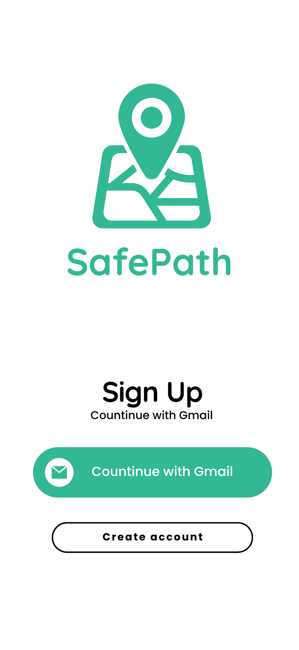

SafePath
Home
Product
Service
Contact
TASK 5
UI Design and Implementation
Road Sign and Road State Mobile Notification Application (SafePath)
GROUP 1

Slide 2
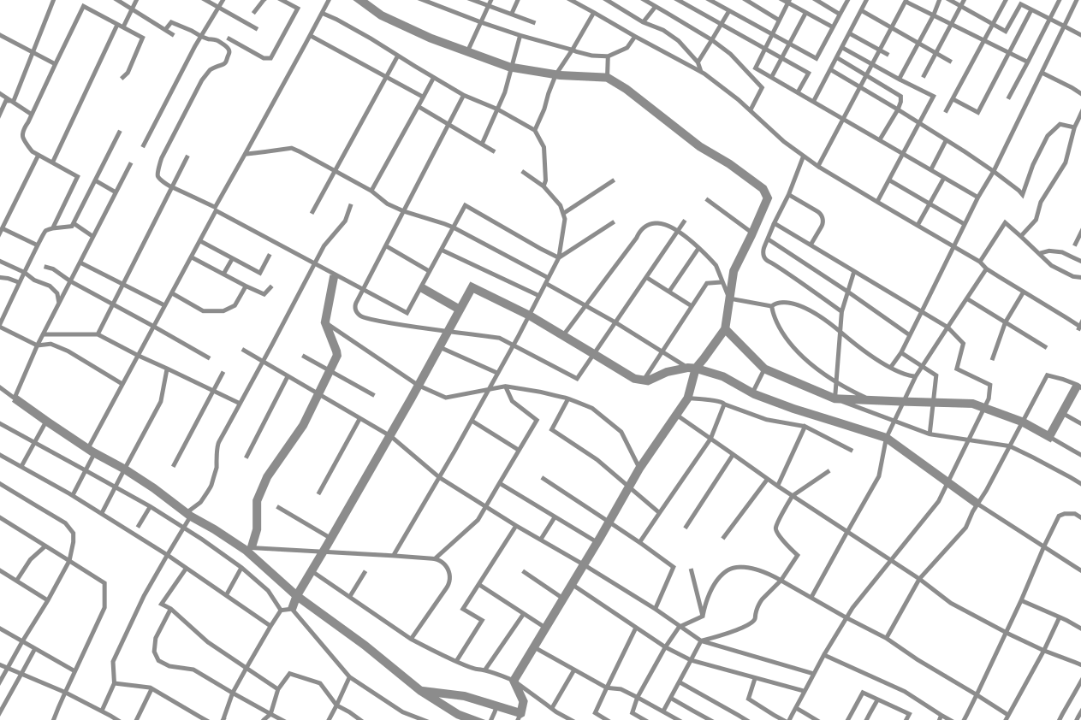



SafePath
Home
Product
Service
Contact
AGENDA
App Name & Mission
01
Low Fidelity Wireframes
05
App Structure
02
High Fidelity Interfaces
06
Brand Identity & Logo
03
Frontend Implementation
07
Typography and Iconography
04
Conclusion
08
00

Slide 3
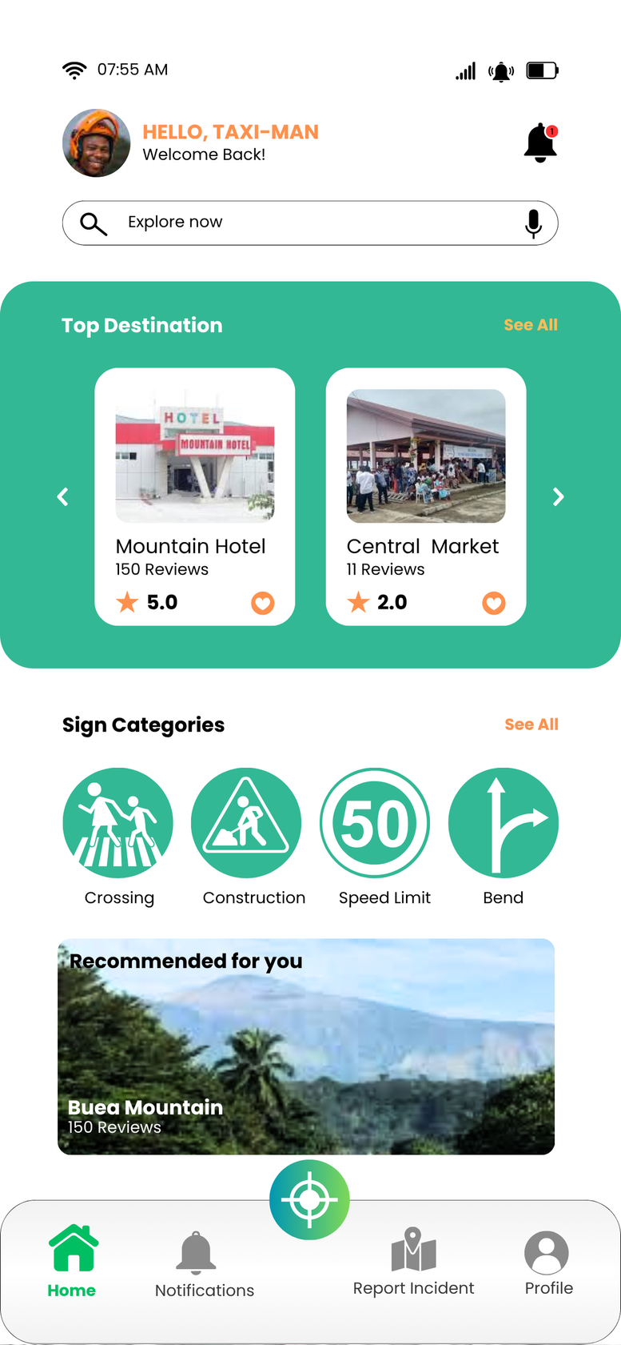

SafePath
Home
Product
Service
Contact
App Name & Mission
Safe Path
Mission Statement:
“Real-time insights for smarter driving and safer roads”
Purpose & Target Audience
SafePath is a mobile application designed to deliver notifications about road signs, traffic conditions, and emergency updates. By combining a comprehensive road-sign library with location-based alerts, SafePath helps drivers make informed decisions, avoid hazards, and contribute insights back to the community.
Target Audience:
Individual drivers (personal vehicles, bus/taxi users, ride-share drivers)
Road safety personnel (traffic officers, transportation agencies)
General road users in urban and semi-urban regions

Slide 4
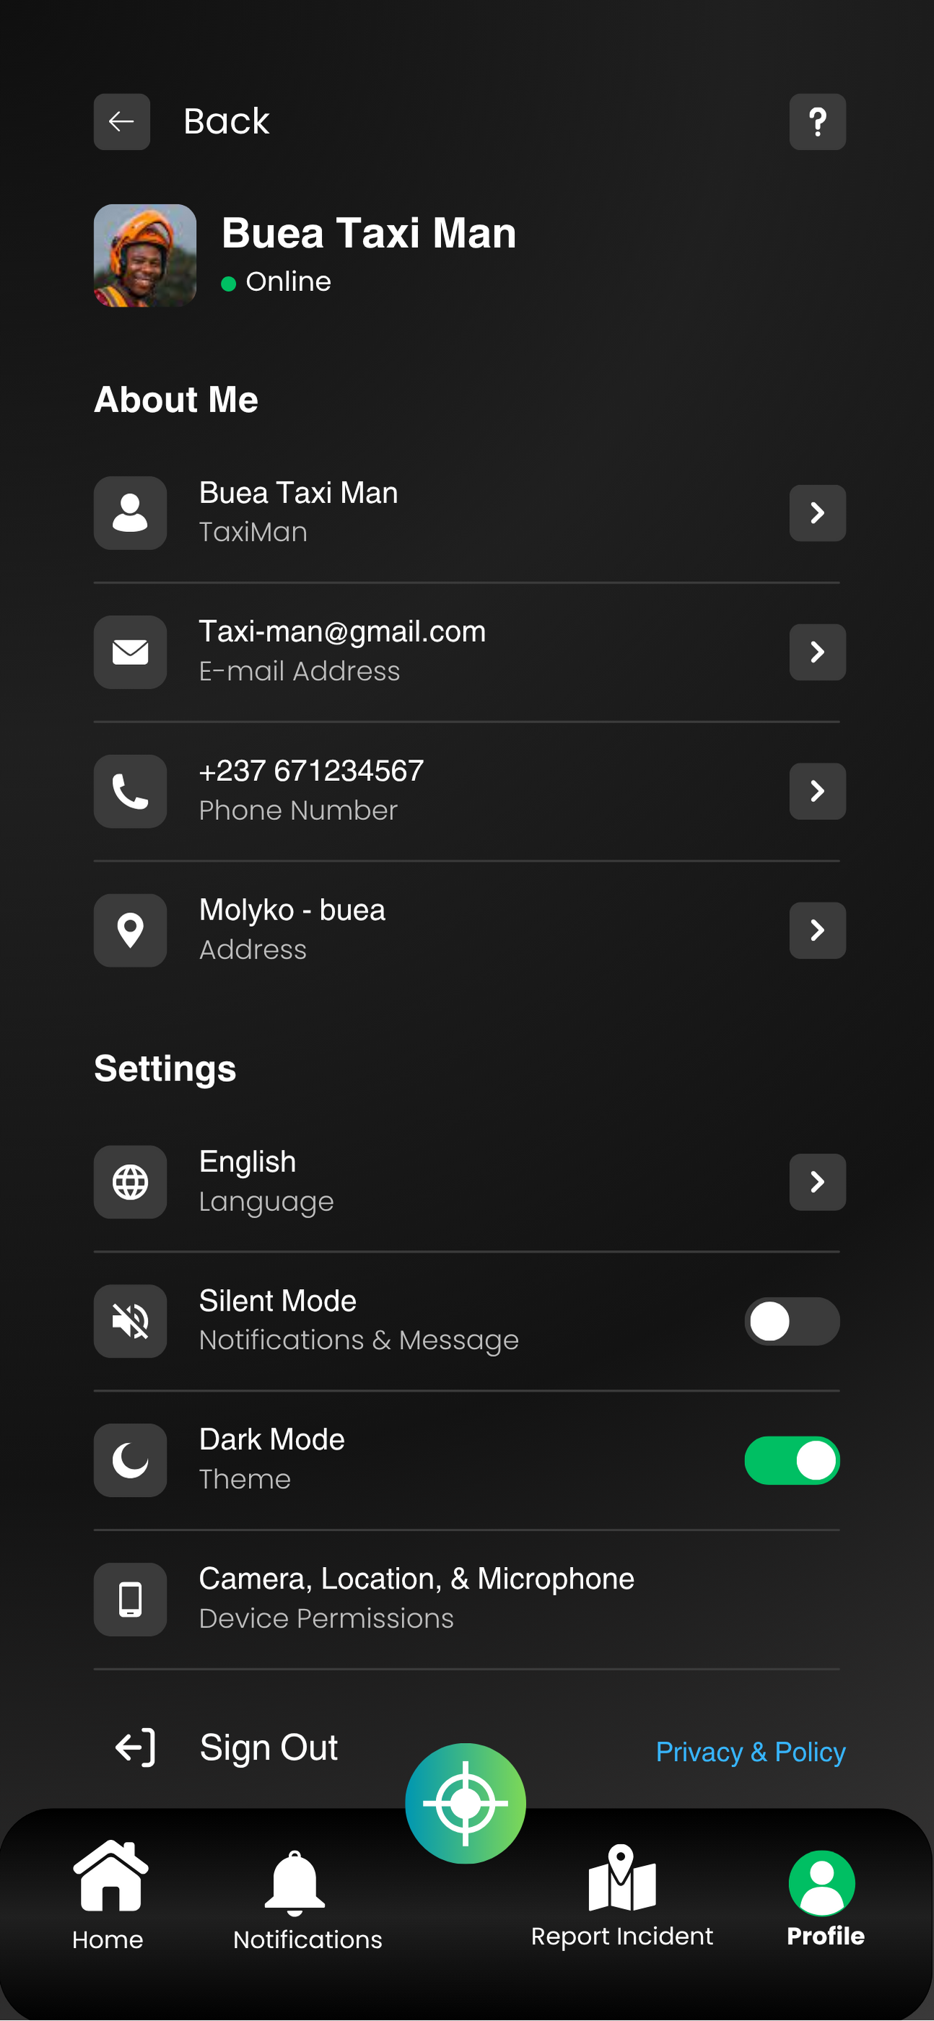
SafePath
Home
Product
Service
Contact
App Structure
Home
Alerts / Notifications
Report Incident /Emergency Contact
Settings / User Profile
Overview dashboard with quick access to the road sign library, trending alerts, and search o Map preview showing nearby alerts
Chronological feed of all active alerts (traffic, weather, closures)
Filter by type (Traffic, Weather, Emergency)
Live Google Map Updates
Profile information (name, email)
Notification preferences
Dark mode / Light mode toggle
Logout / Account deletion
A contribution interface where users can submit new hazards or incorrect/missing signs
Option to attach a photo, select sign category, and add descriptive text.

Slide 5

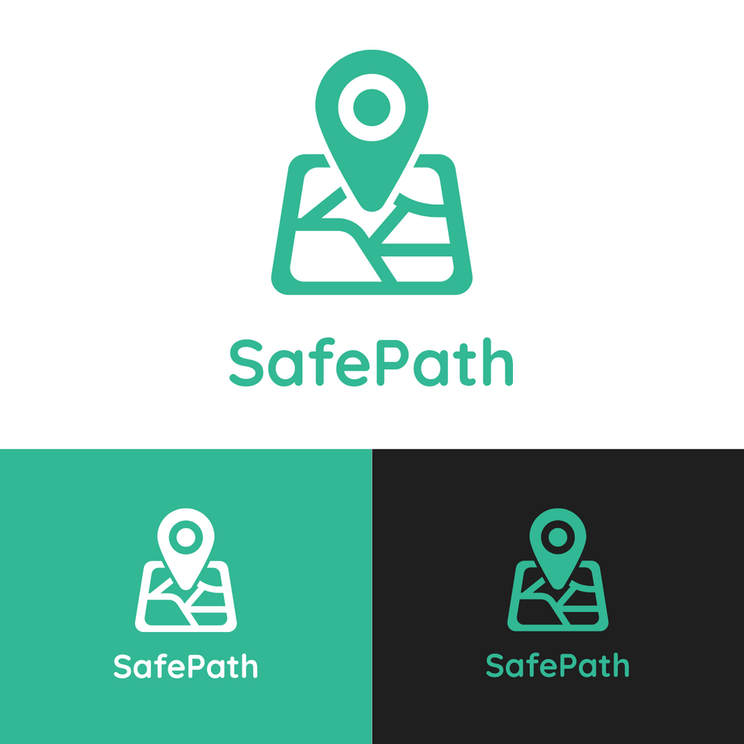
SafePath
Home
Product
Service
Contact
Brand Identity and Logo (1)

Slide 6
SafePath
Home
Product
Service
Contact
Brand Identity and Logo (2)
(Colour Psychology)
#1F1F1F
#FF914D
#32B895
#FF914D
#FFFFFF
Background for most screens (clean, minimal distractions). Enhances contrast with text/icons.
Maintains readability and reduces eye strain in low-light. Conveys sophistication and focus
Represents growth, balance, Promotes calmness and trust, reducing driver stress.safety. •Green is associated with “go” signals (positive, reassuring)
Used sparingly for secondary Call to actions like “see more”
Gives the App a Modern Clean Look
Visual Brand Identity
SafePath colour palette

Slide 7
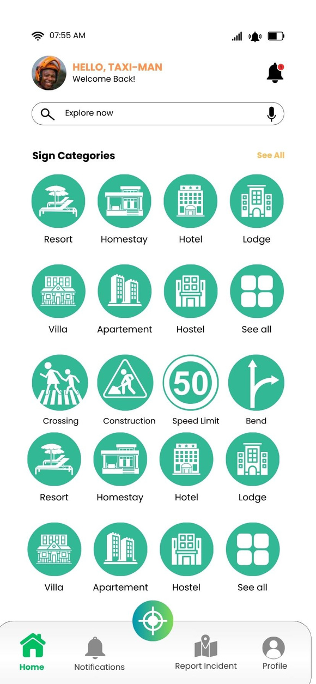
SafePath
Home
Product
Service
Contact
Typography and Iconography
Iconography
Typography
All icons are custom-designed or sourced from a consistent vector set (Canva) and optimized as SVG files for crispness on Retina/HD screens.
Road sign icons: high-contrast white silhouette on green circular backgrounds (default), switching to black-on-white in light mode.
Action icons (home, alerts, report, settings) use minimalist line-art style in black or white, depending on background.
Poppins (Primary Font)
Headings: Poppins Bold, 18–24pt
Subheadings: Poppins SemiBold, 16–18pt
Body Text: Poppins Regular, 14–16pt
Captions: Poppins Light, 12–14pt
Quicksand (Logo Only):
Used at 32–48pt on splash and onboarding screens for brand name.
Aa Poppins
Aa QuickSand

Slide 8
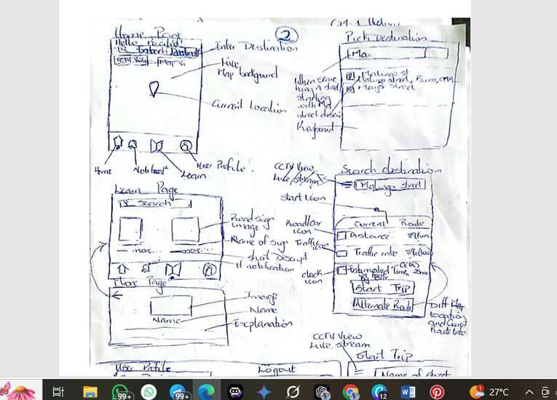
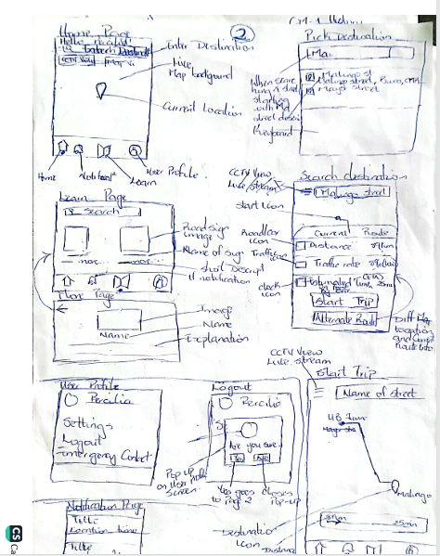
SafePath
Home
Product
Service
Contact
Low Fidelity Wireframes
Before moving into high-fidelity mockups, low-fidelity wireframes were sketched to validate layout, user flow, and screen hierarchy.
These sketches were done on paper and then scanned and photographed into Canva as reference layers.

Slide 9
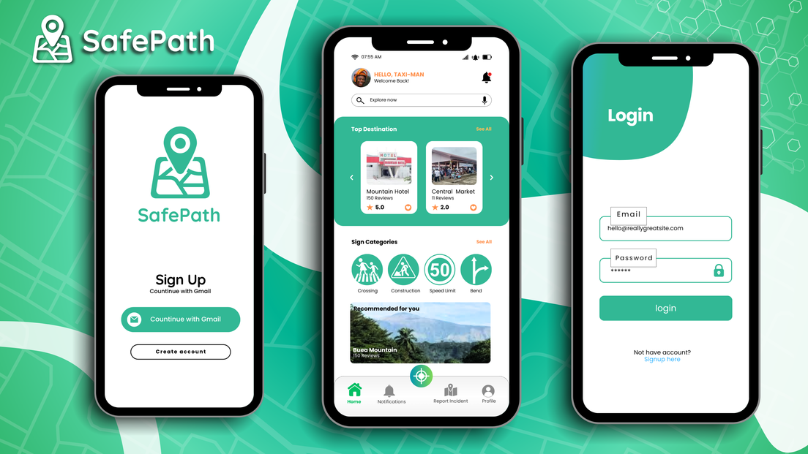
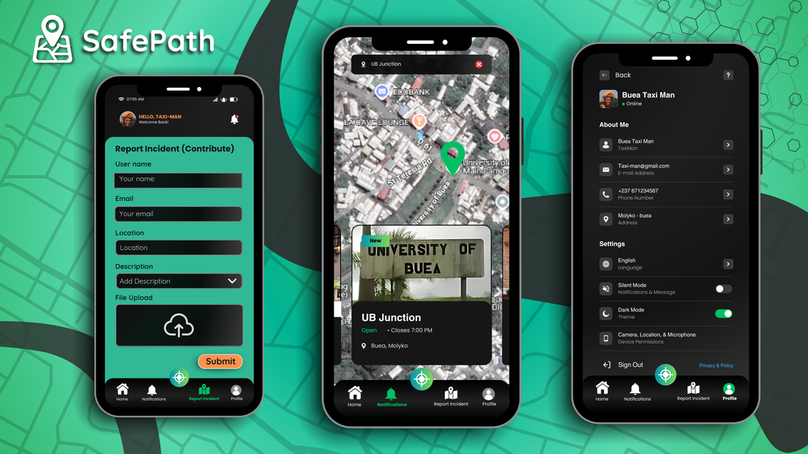
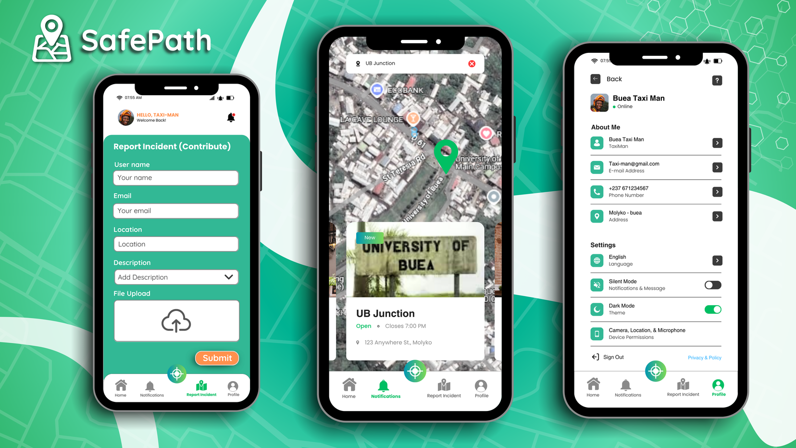
SafePath
Home
Product
Service
Contact
High Fidelity Interfaces
Using the color palette, typography, and iconography guidelines above, the following key screens were designed in Canva
consistent icon sets were used to represent:
• Road sign categories (e.g., Stop, Speed Limit)
• Navigation (home, alert, settings)
• Alerts (⚠️, 🚧, ⛔)
Icons are vector-based and optimized for high-resolution mobile screens

Slide 10
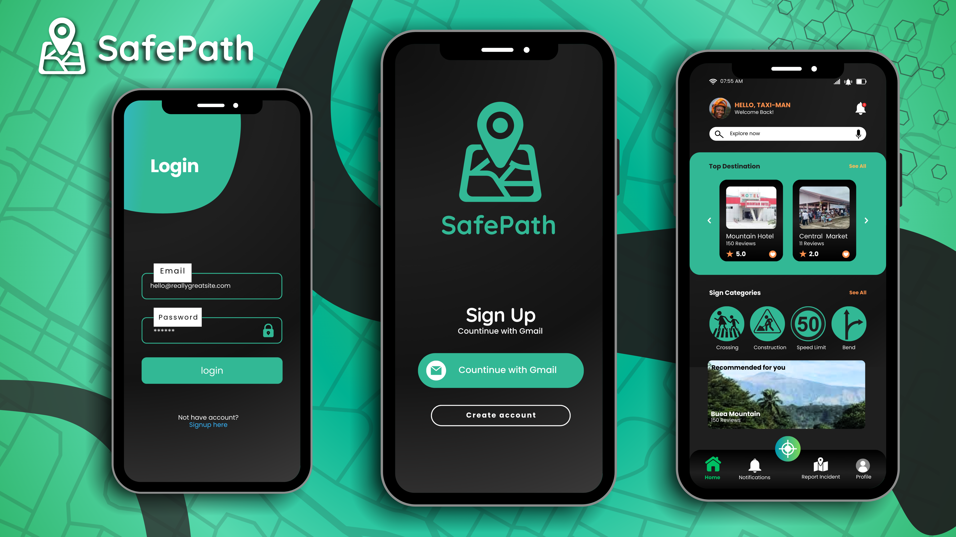
SafePath
Home
Product
Service
Contact
High Fidelity Interfaces

Slide 11

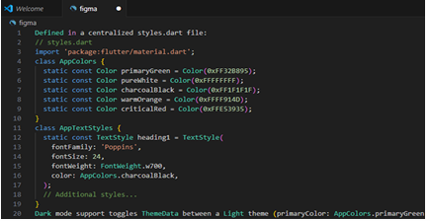
Home
Product
Service
Contact
Front-End Implementation
Why Flutter?
• Cross-Platform Support:
A single Dart codebase binaries for both iOS and Android.
• UI-Centric Architecture:
Flutter’s widget-based system aligns perfectly with our Canva component-driven design
• Hot Reload:
Immediate preview of design changes accelerates development
• Package Ecosystem:
Prebuilt packages for maps (google_maps_flutter), notifications (firebase_messaging), and HTTP calls (http or dio) allow us to focus on core features rather than plumbing

Slide 12
SafePath
Home
Product
Service
Contact
Conclusion
The UI design of SafePath application was developed to be clean, intuitive, and visually aligned with the purpose of delivering important road-related notifications to users in a fast, recognizable format.
See you in Task 6

Slide 13
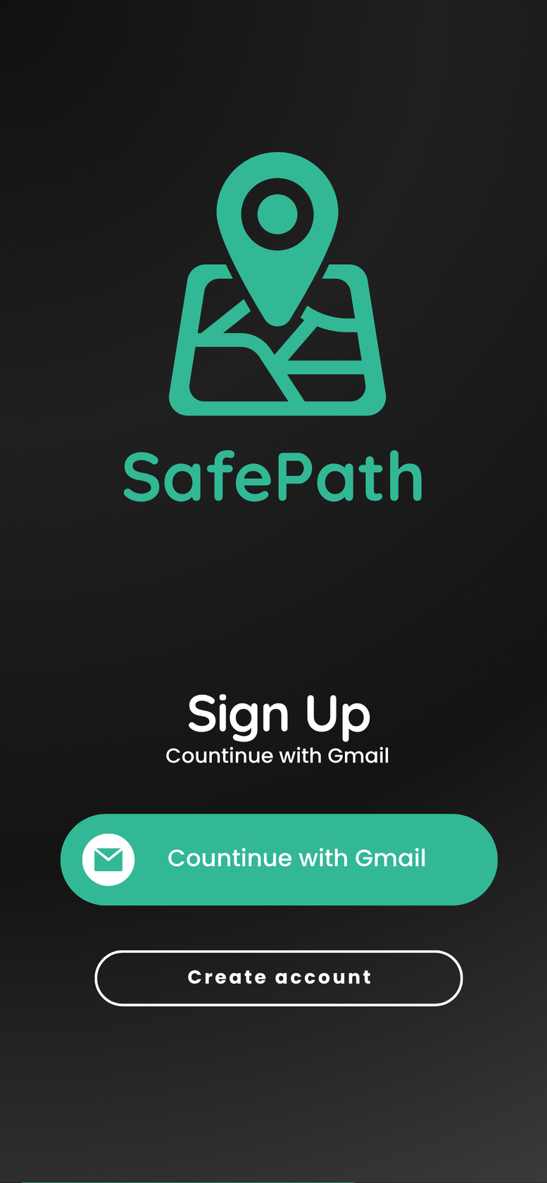
SafePath
Home
Product
Service
Contact
TASK 5
THANK YOU
Road Sign and Road State Mobile Notification Application (SafePath)
GROUP 1

